Slide 1
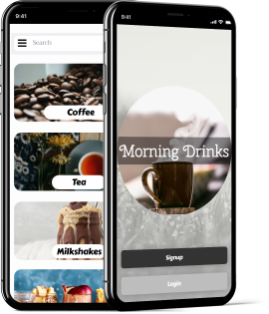
Morning Drinks
A better way to start your Day!
By Hassan Sajid
Role: UX & UI Designer and Usability testing
Durations 6 weeks

Slide 2
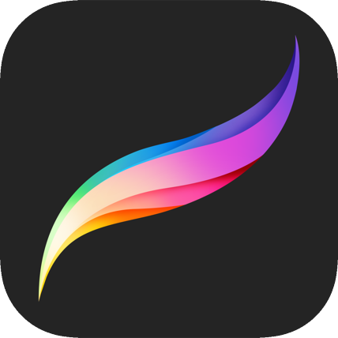
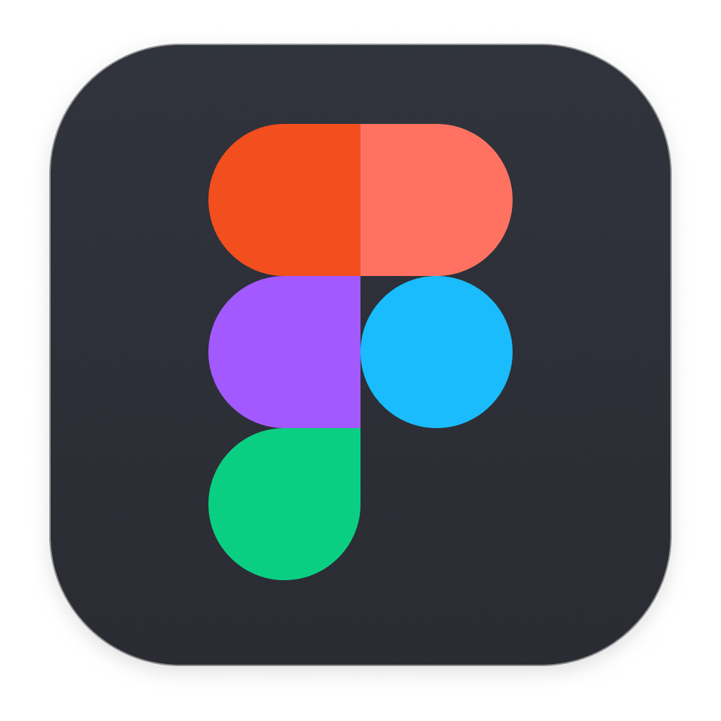



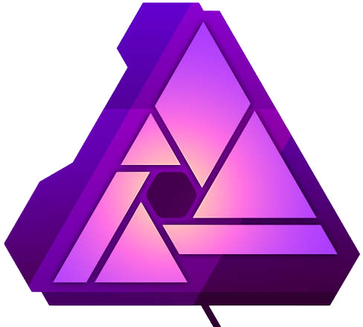
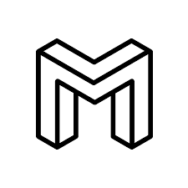
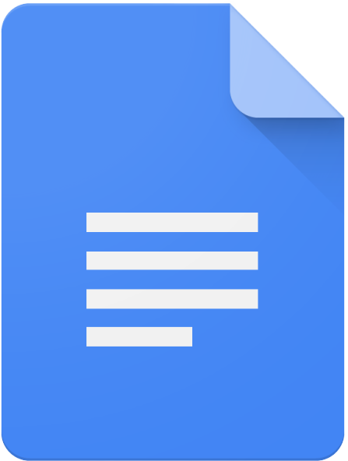
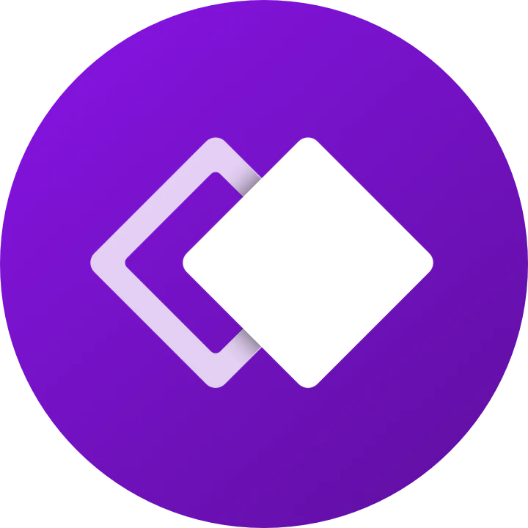
Tools used for the project
Procreate
Figma
Miro
Zeplin
Lookback
Affinity Photo
Mobbin
Google Docs
Whimsical

Slide 3
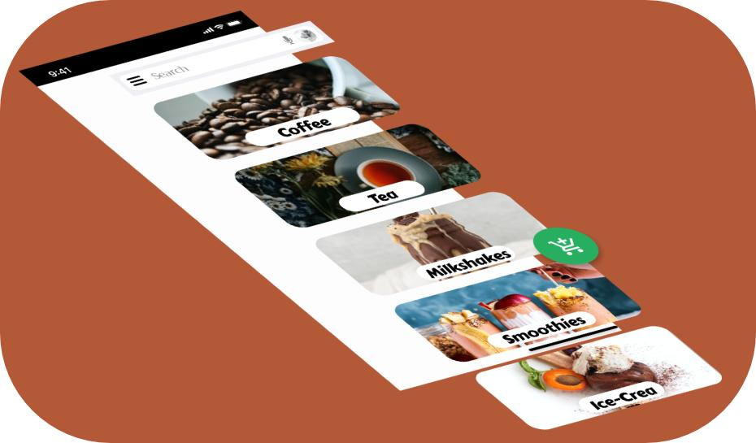
What is ‘Morning Drinks’? And Why?
Morning Drinks is an app for office cafes. During the Coronavirus outbreak it is essential that office staff maintain their distance and avoid crowded places.
The app can be used by office staff to order and pay for their coffee while they are on their desks. The app will give the user approximate time till the coffee will be ready to collect. This means the cafe customer will spend less time in cafe and will speed up the flow of customer drastically.

Slide 4
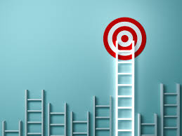
Goals
To make an which allows users to:
order their choice of drink from their desk
to pay for their drinks
to track and know when their drinks are ready
to save some drinks as favorite, to the make the process even quicker for them.
Order multiple drinks at a time

Slide 5
Problems & Solutions
Problems
Solutions
01
App needs to let users pick from their choice of drink.
App needs to update users on when their drink will be ready.
During the pandemic having to wait for the drinks in the cafe will put customers and staff at risk.
01
App needs to have all drinks from the menu.
Estimate time till the drink will be ready and update in case there is delay
App needs to take payments so users don’t have to queue in the cafe to make payment.
02
02
03
03

Slide 6
“Be not entangled in the world of Days and Nights; Thou hast another time and space as well.”
Allama Muhammed Iqbal

Slide 7
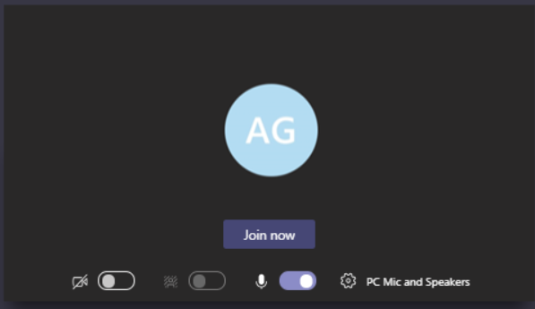
User Research
To start my research I sent an email around my office (to about 120 individuals) inviting them to take part in my project. From those who replied I picked 5 at random for initial interviews and kept the list of all interested for user testing later on.
These interviews allowed me to create user profiles and reflect on my goals and targets.
All interviews were done via Microsoft teams.

Slide 8
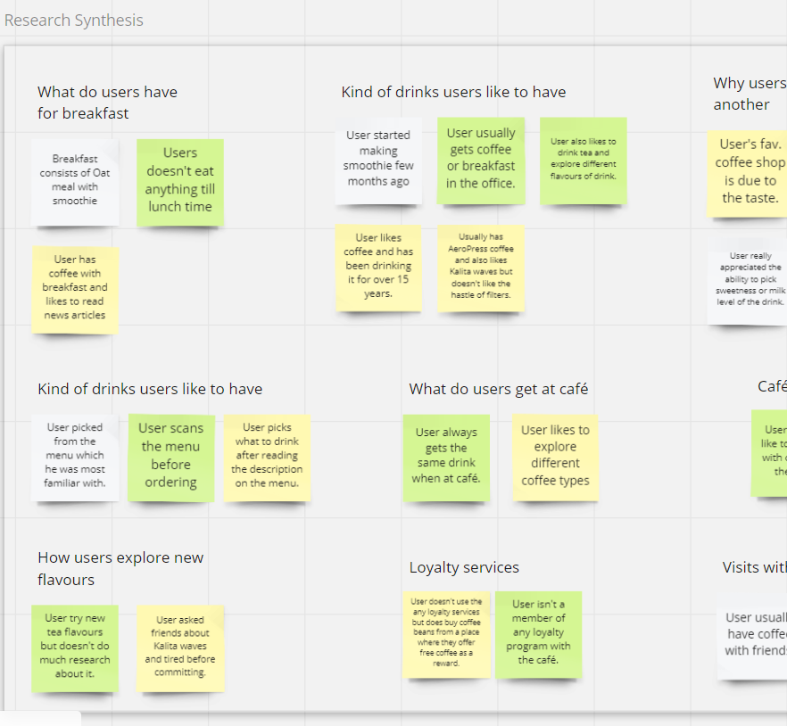
User Analysis
With the interview done now it was time for analysis.
With the information on hand I created Affinity diagram on Miro.
Miro is allowed me to create digital white board and which I used to group my findings and prioritise work via Value vs Complexity graph.

Slide 9
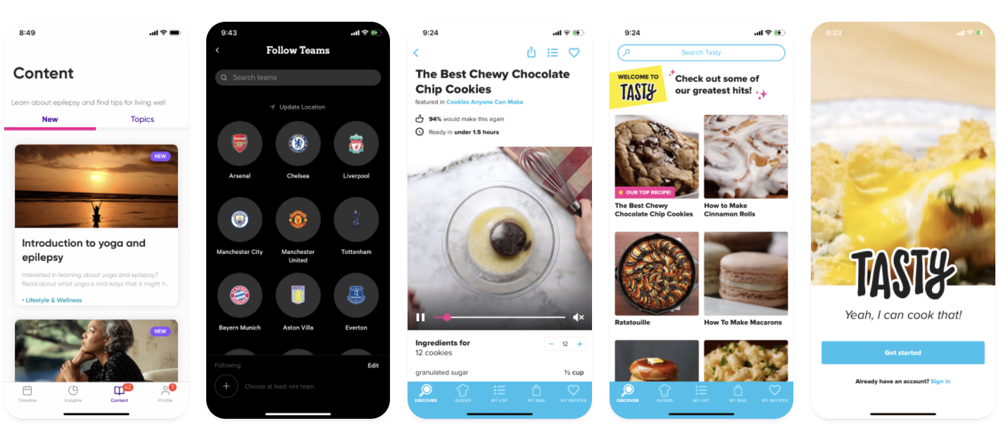
Moodboard

Slide 10
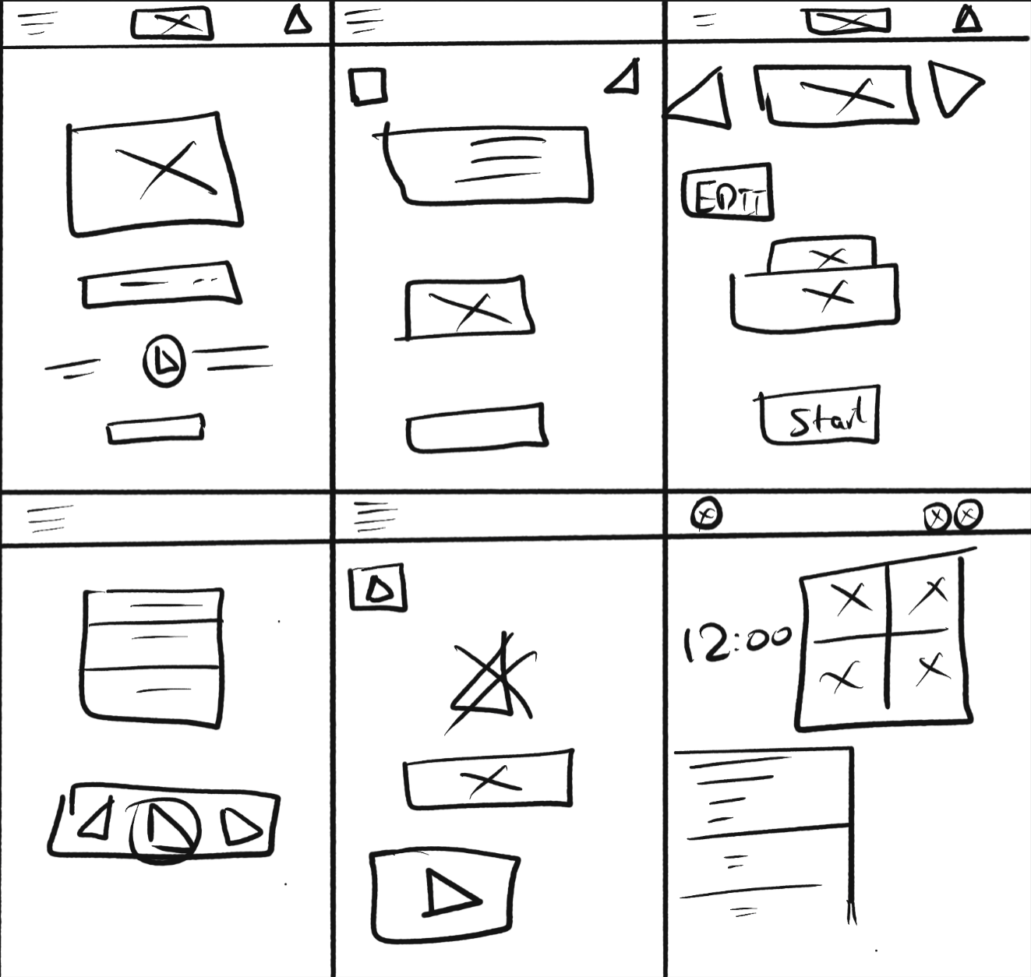
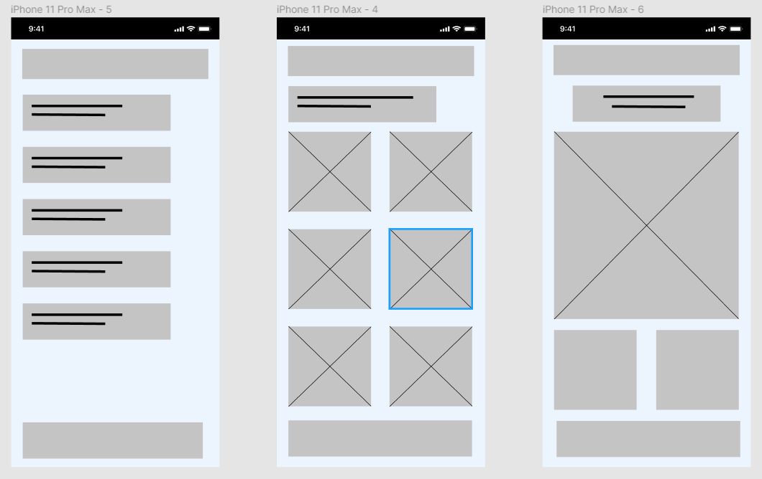
Design, Sketching & early Prototyping
To start my design process I used Crazy-8 technique which allowed me to quickly get some ideas down and which I later on expanded on.
All of my low fidelity sketches were done on Procreate which were later moved to Figma.

Slide 11
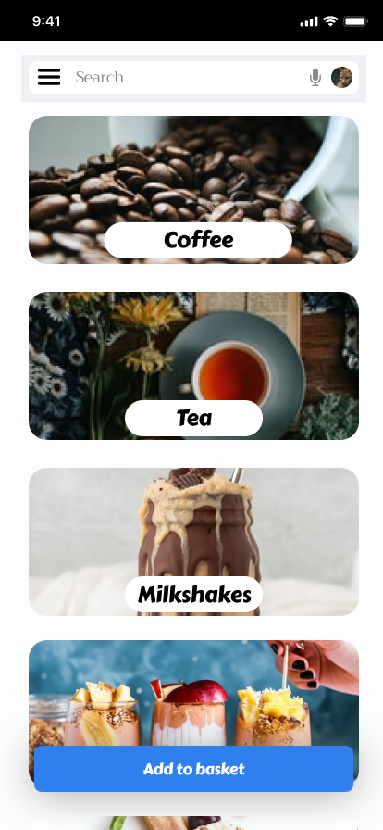
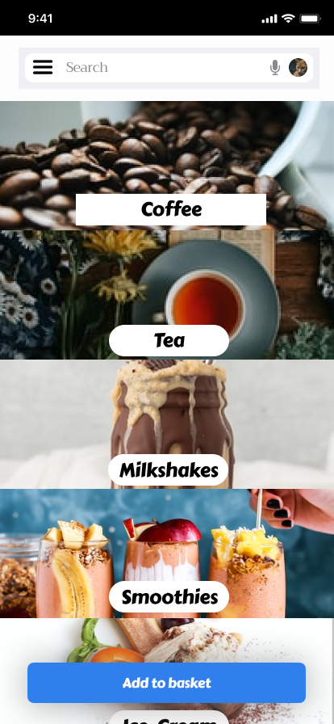
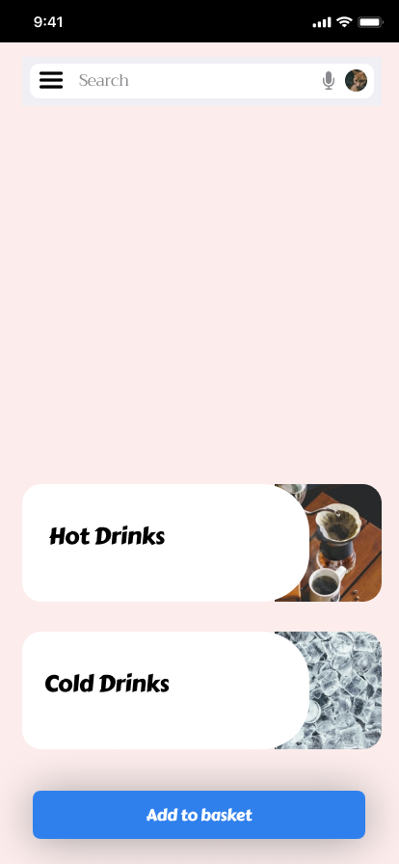
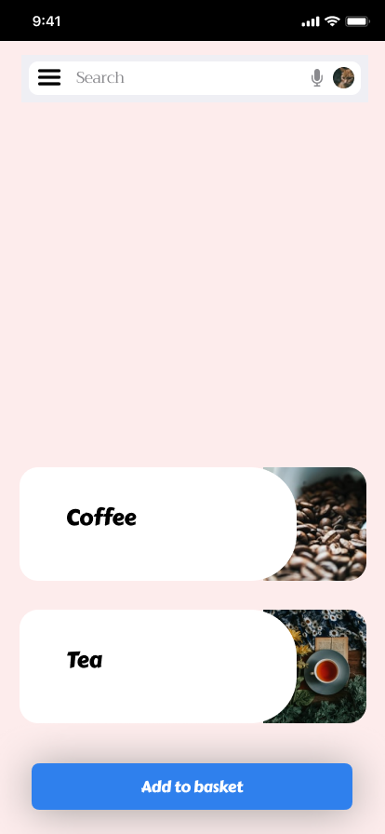
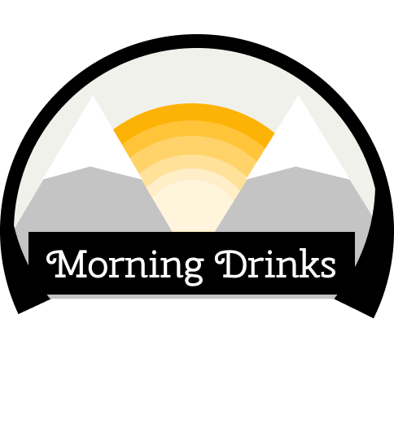
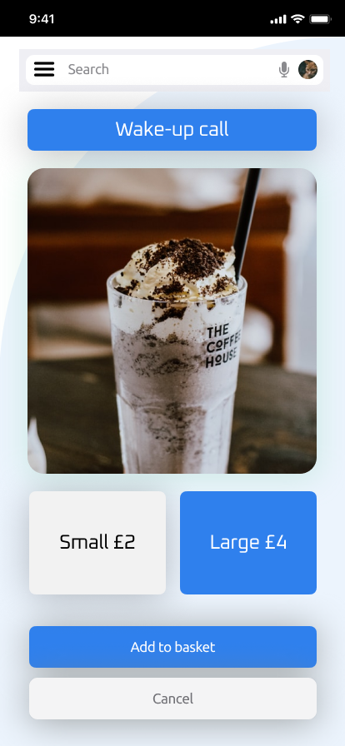
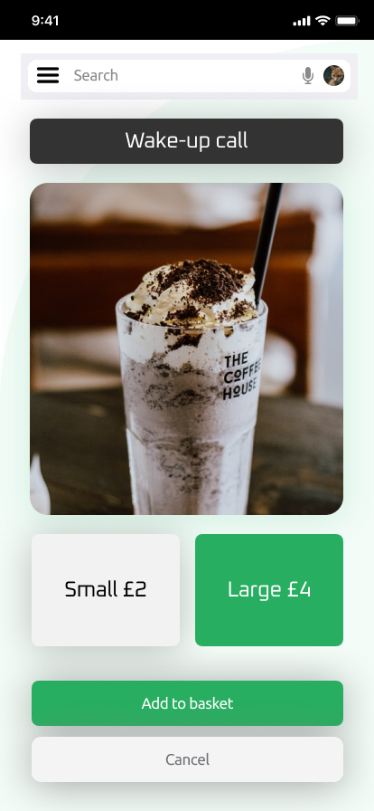
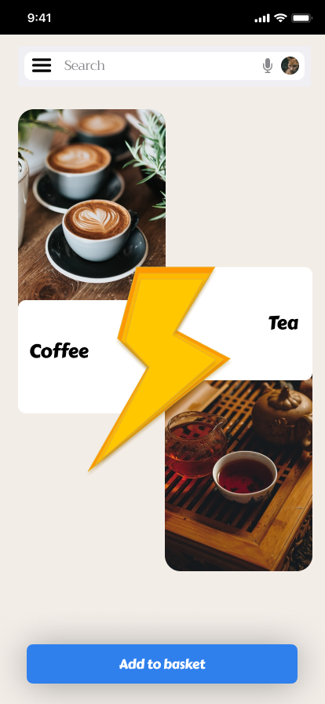
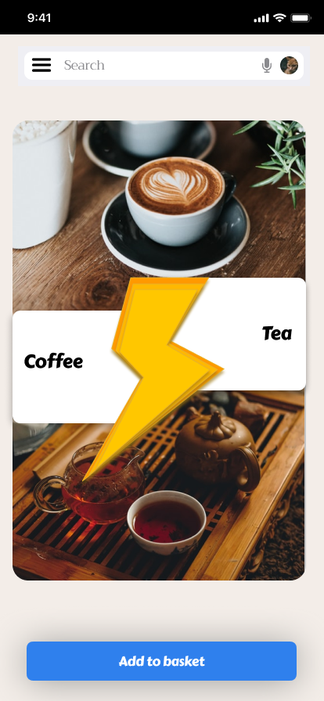
Detailed Prototyping, Testing & Iterations
User engagement has always been important part of my project.
To make sure my designs were user centric I starting consulting with some interviewees early on. This helped me get some great feedback and kept them engaged with the project.
For this test I used the technique of A/B testing and with the feedback helped me with finalising my designs and layout.

Slide 12
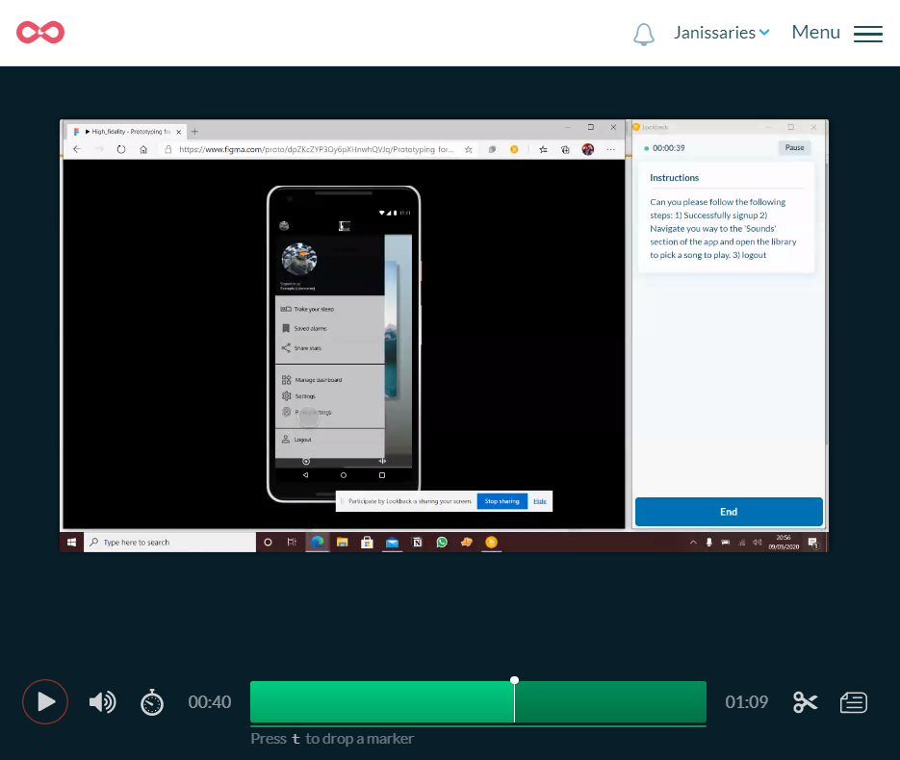
Wider audience Testing & more Iterations
Using Lookback I sent my high-fidelity designs to a wider audience. I sent the link again to all those who wanted to be part of the process and gave them 2 weeks to give their feedbacks.
After 2 weeks I was able to look at how individuals interacted with my final design and areas where they go stuck.
This allowed me to make some final adjustments and iterations.

Slide 13
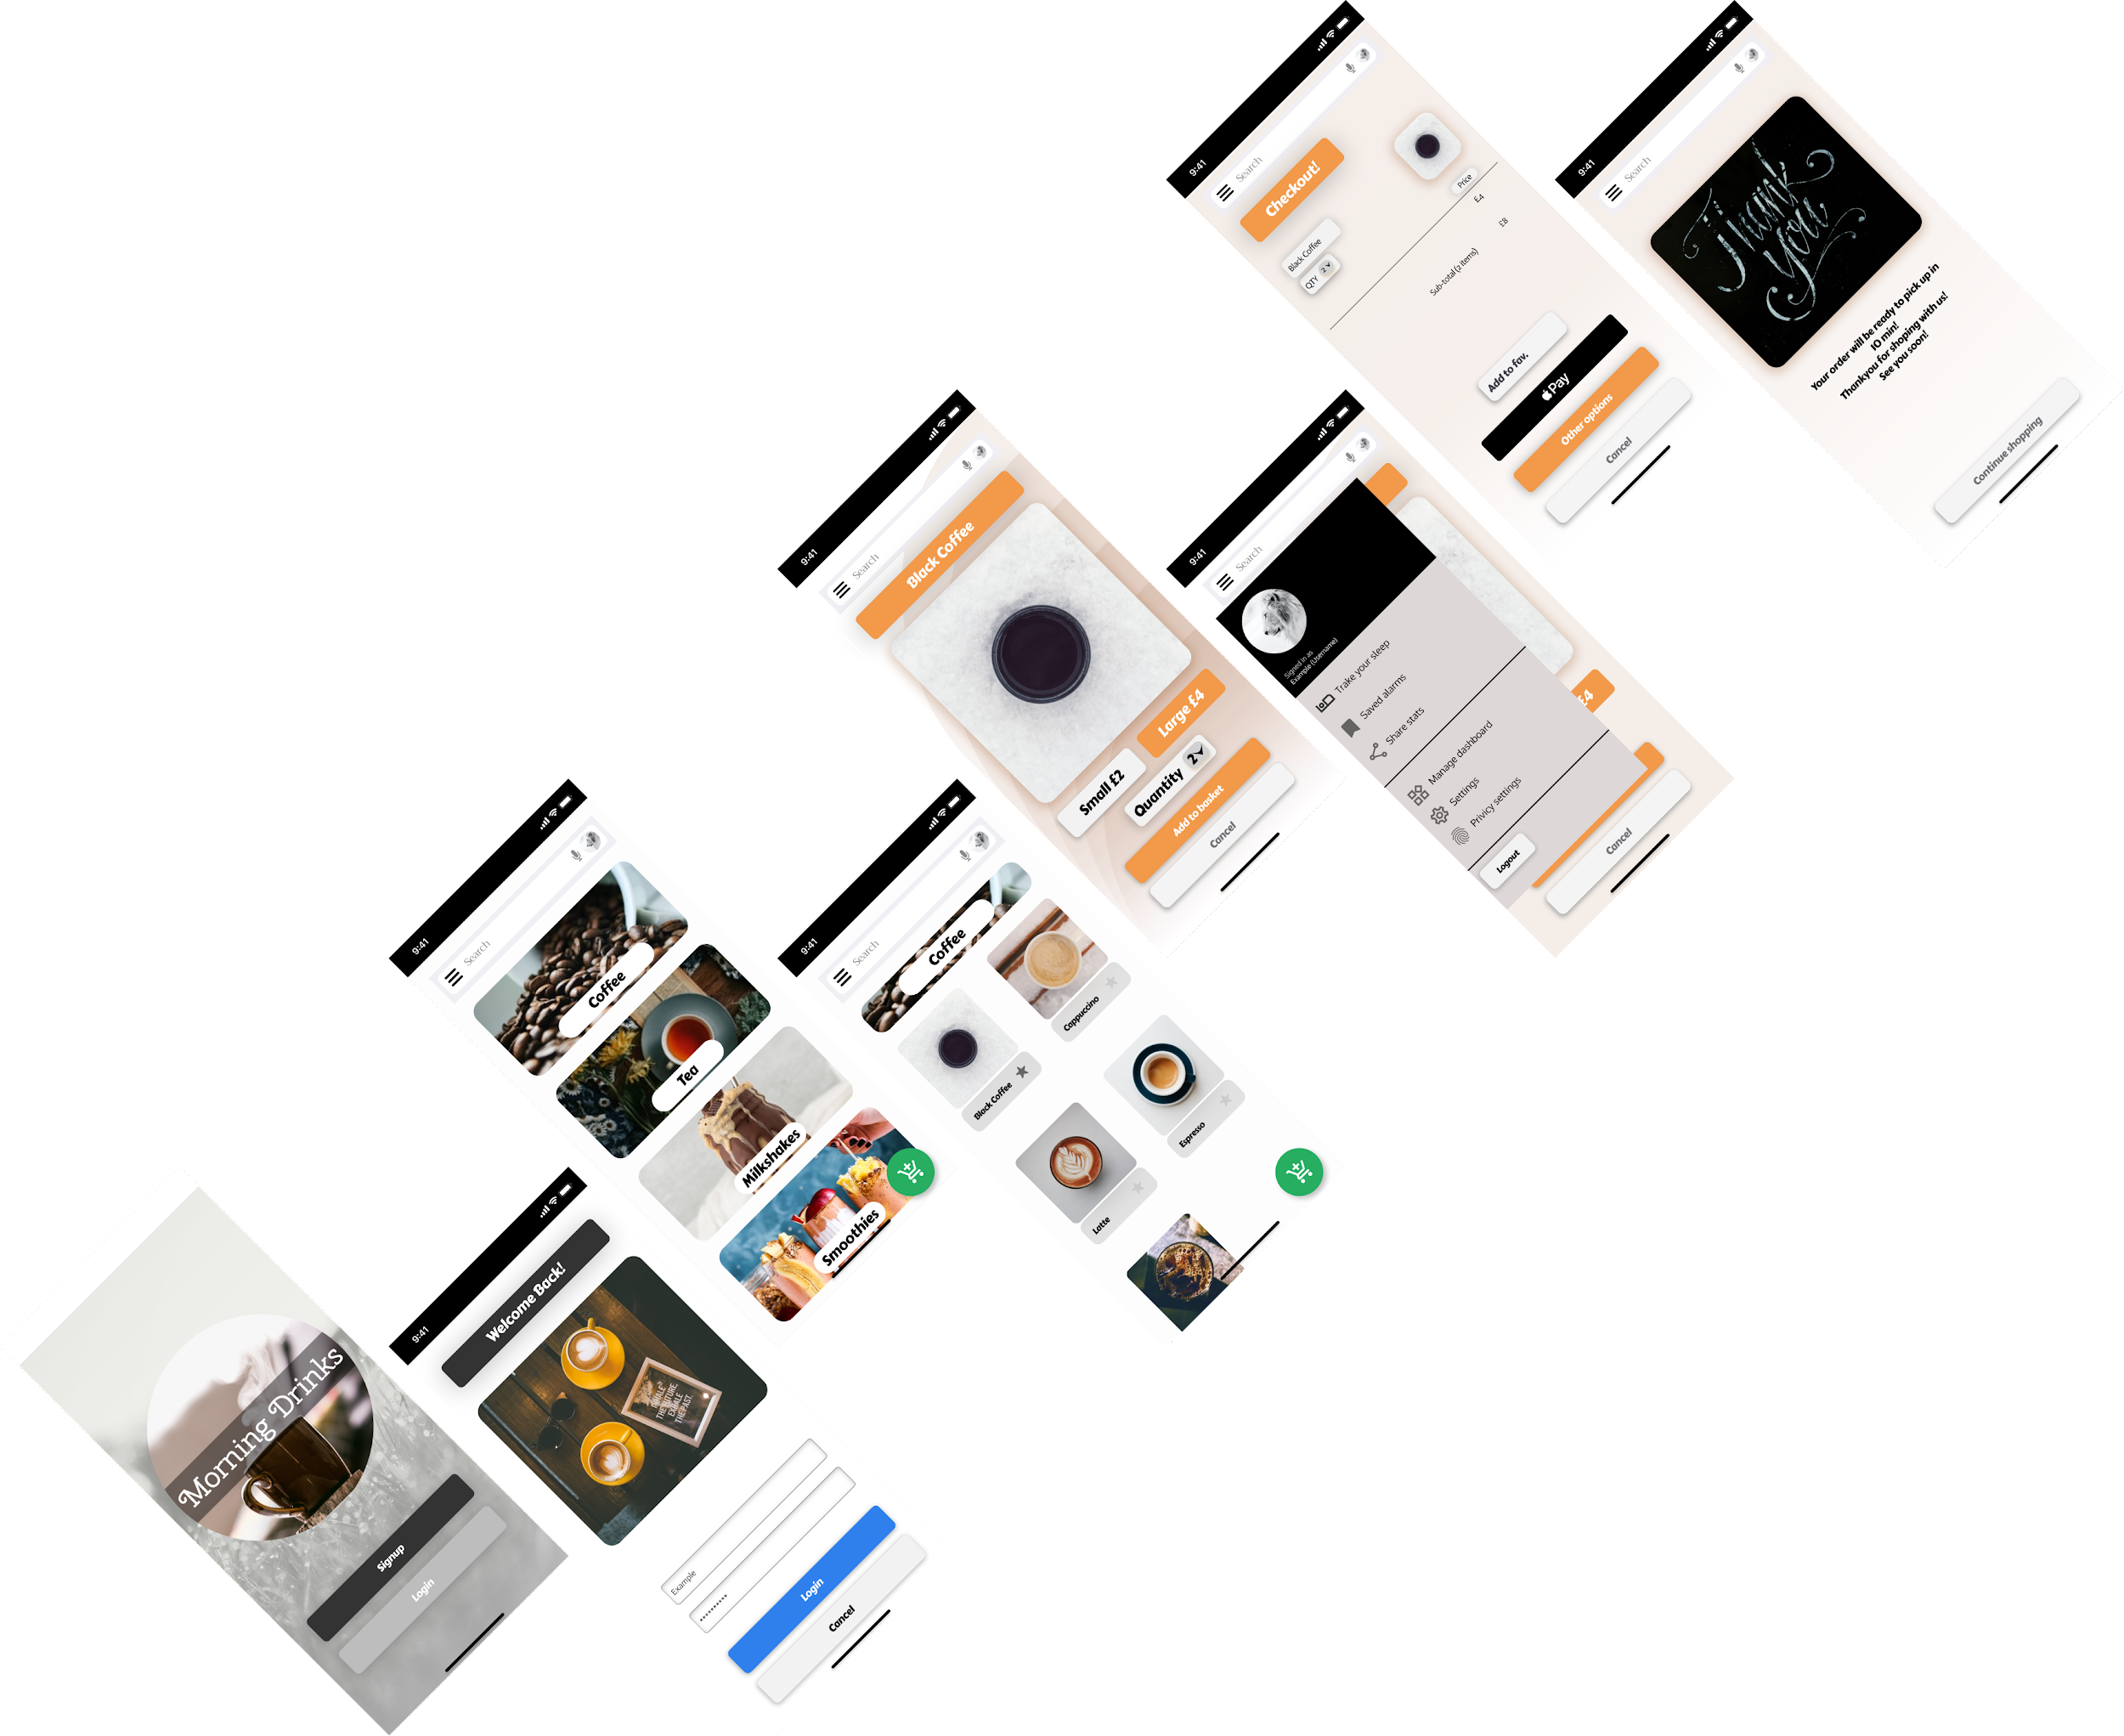
Prototype Link
https://www.figma.com/proto/wUG01K9s4gCaYfM0k1pqxB/Morning-Drinks?node-id=41%3A13840&scaling=scale-down

Slide 14
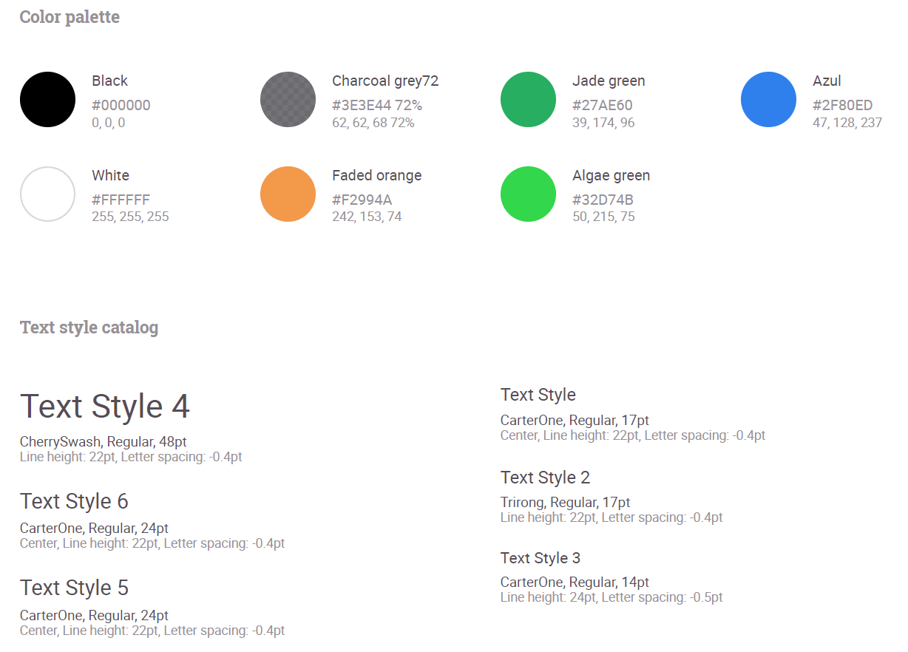
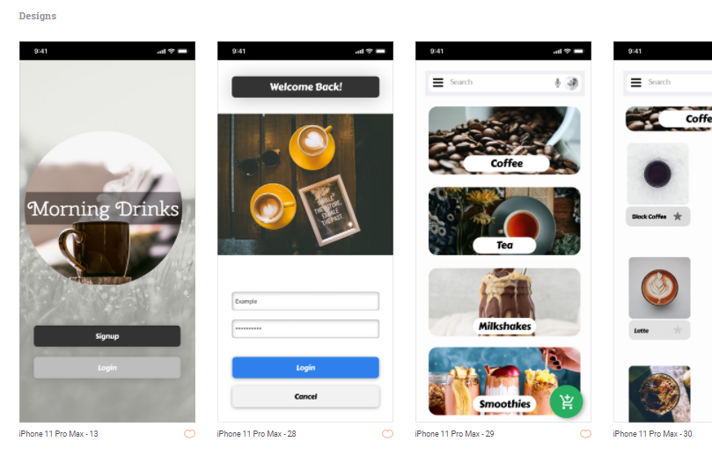
Style Guide
Link to Zeplin Style Guide: https://scene.zeplin.io/project/5fa556236ea59404d58c096c

Slide 15
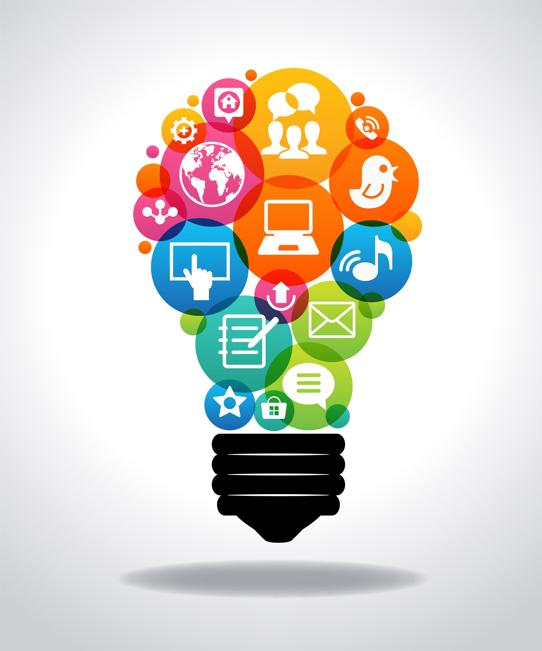
What I learned
I learned how to engage with the user and understand needs and requirements.
I also learned and developed my Figma knowledge.
The aim was to create a product which helps cafe staff and customers stay safe during these tough times and I really hope Morning Drinks can help towards achieving that goal.

